Slide 1

Mobile Collaboration of anti-HT Efforts
Solving social service challenges with technology
    Esther Ministry
    Ray Manning

Slide 2
Opportunity
Match organizations WITH resources to those who NEED them
Provide web/mobile based questionnaire for people fighting human trafficking
Match NEEDS as they arise WITH resource providers
Allow providers to be one-time provider or have regular requests for help
Allow network to “build itself out” with online sign-up (rather than in person)

Slide 3
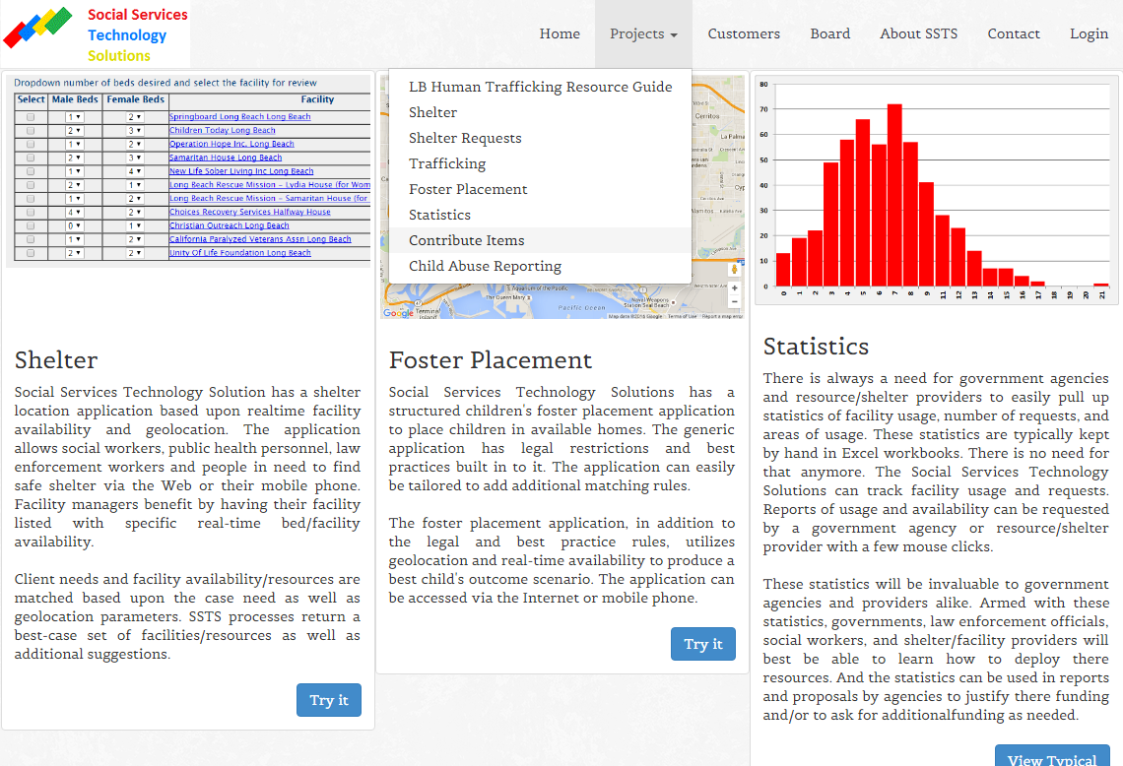
Questionnaire
Point any web or mobile browser to www.sotechsol.com and select “Contribute Items” under Projects

Slide 4
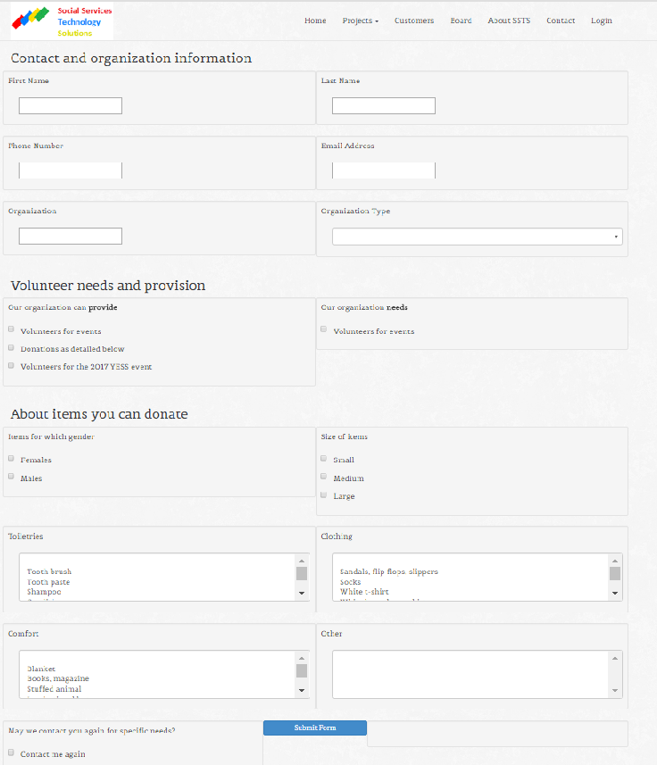
Questionnaire
One page form
  Organization information
  Volunteer needs/provision
  Donation information
Still finalizing form for organization’s needs
Web-based but runs on mobile platforms for field use

Slide 5
Questionnaire
Finalizing questionnaire
  Basic organization and contact information
Additional
  Can you donate items for “survival” packs
  Do you need items for “survival” packs
  Can you provide volunteers for events
  Do you need volunteers for events
  Can you work the YESS event in February 2017?

Slide 6
Finding HT Resources
Easy to find a list of shelters (i.e., shotgun)
  www.shelterlistings.org
Have to call each one to find availability
How many calls do you make before you give up?

Slide 7
Finding HT Resources
Point any web or mobile browser to www.sotechsol.com and select “LB Human Trafficking Resource Guide” under Projects

Slide 8

Finding HT Resources
If you provided information for this document, then you need to try the website
Resources searchable via category and zipcode via any web/mobile device
Corrections can be made within a day – alleviating the “outdatedness” of a paper directory

Slide 9
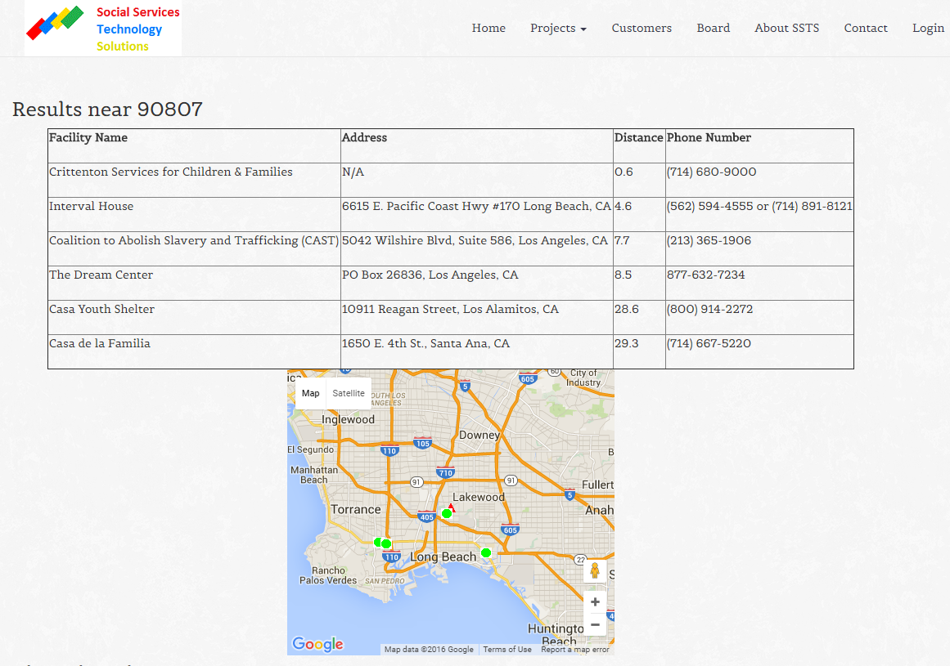
Finding HT Resources

Slide 10
Contacts
Esther Ministry estherministry1@gmail.com
Ray Manning, PhD ray@sotechsol.com
www.sotechsol.com

