Slide 1
Social Services Technology Solutions
Solving social service challenges with technology
Ray Manning
CEO

Slide 2
Opportunity
Homelessness is a complex issue
Solutions involve
Finding shelter
Diagnosis
Treatment
Enforcement
Risk reduction
Technology

Slide 3
Finding Shelter
Easy to find a list of shelters (i.e., shotgun)
www.shelterlistings.org
Have to call each one to find availability
How many calls do you make before you give up?

Slide 4
Finding Shelter
Use single site portal that includes facility availability
Engage shelters to regularly update availability
Portal can be self-policing for abuse (i.e., shelters that list beds available when they are full)

Slide 5
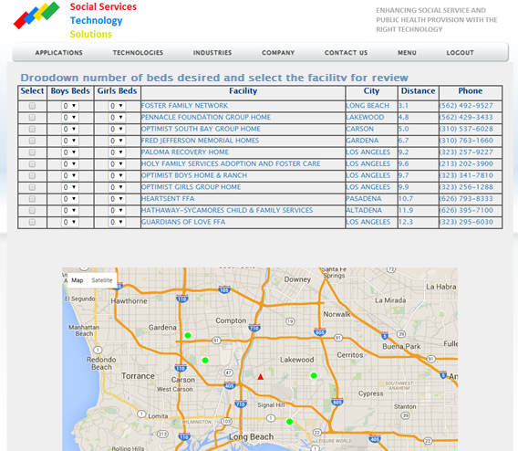
Finding Shelter

Slide 6


Competitive Advantage
 | Shelter Listing | Shelter Openings | Provider Updates | Feedback Statistics
SSTS
Business as Usual
Current Competitors
Upcoming Competitors

Slide 7
Current Status
Basic search, geolocation, and facility availability framework is in place (from prior domestic violence and human trafficking efforts)
Need to engage ~2400 California shelters to provide facility availability (into homeless shelter database)
Need to optimize site for mobile devices

Slide 8
Maintaining The Advantage
No significant intellectual property in the process
Get to market first
Service the customers best
Provide feedback statistics regarding increased shelter utilization (and income) when using the SSTS process

Slide 9
Business Model
Shelter providers receive money for beds filled
SSTS will take a cut of shelter provider referrals and/or bed filling from SSTS referrals
But shelters will see increased bed utilization and income with the SSTS process
Shelter providers will have to update facility availability numbers
Update facility web form
Respond to automated email
Respond to automated SMS

Slide 10
Projected Revenues
Currently 730,000 beds in the USA for homeless people*
Estimated 100,000 beds unfilled each day
Average cost of $13,000 per bed per year ($35 per day)**
Filling 10% of unfilled beds and charging 10% of daily rate yields revenue of $12M per year
* “The 2013 Annual Homeless Assessment Report to Congress,: Part 1”, Henry, Cortes, and Morris, 2013.
** “Homeless service delivery in the context of the Continuum of Care”, Administration of Social Work, Wong and Nemon, 2005.

Slide 11
The Team
Ray Manning, PhD, CEO – Aerospace engineer, algorithm/programming geek
Ruby Guillen, MSW, MSCS – Children’s adoption social worker
Joseph Powers, MSW – School principal, former children’s adoption social worker
Lisa Powers, MSW – Senior center social worker
Albert Heng, Accountant
Currently recruiting sales and marketing team members

Slide 12
Closing Slide
Ray Manning, PhD
CEO
ray@sotechsol.com
www.sotechsol.com
www.sotechsol.com/shelter.html
562-548-0509 (SSTS)
562-972-0509 (mobile)

