Slide 1
YOUTH AND SOCIAL WORKER CHALLENGES
Service Linkage and Referrals

Slide 2
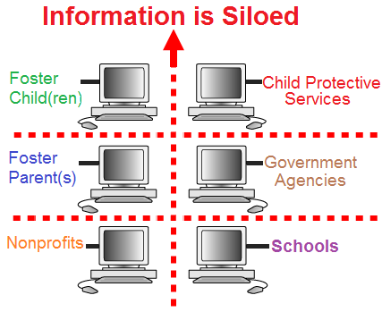
PROBLEM - CURRENT STATE
Problem: Social workers, foster youth, foster parents and/or service providers
are not connected with existing resources in their area
Public Use:
Often people are unaware of services
Information is not updated
Often a referral is a multi-stepped process
Some referrals are not listed on the Internet
Nonprofits
Unstructured and unavailable data
Information management too costly
Technology protocols are hard to understand
Multiple siloed applications

Slide 3

SOLUTION - FUTURE STATE
Optimizing Resource Utilization
Show people how to advocate for themselves
Referral linkages pushed to phone(s)
Relevant referrals to actual issues
Real time service information
Real time referral status
Established electronic appointments
- And many more . . .

Slide 4
DCFS Policy 0080-506.10 for service referrals*
FOR CHILDREN AND FAMILIES, CASE-CARRYING SOCIAL WORKERS:
Complete Structured Decision Making (SDM) tool to assess needed service(s)
Confirm service is: available, affordable, and appropriate (i.e. eligibility criteria, referral form and documents?)
At least 2 service provider referrals (document in service provider notebook)
Document all contact with child, family and service providers
Provide transportation assistance if needed (bus coupons, bus passes from auxiliary fund)
Obtain signed ABCDM 228 release of information parent (youth?)
Referrals are monitored for follow up within 10 days of referral to verify enrollment and participation
Progress notes are updated including written updates from service providers
Assess and provide new referrals as needed
*Victims of crime (VOC) service referrals and funding will be addressed in a future business case

Slide 5
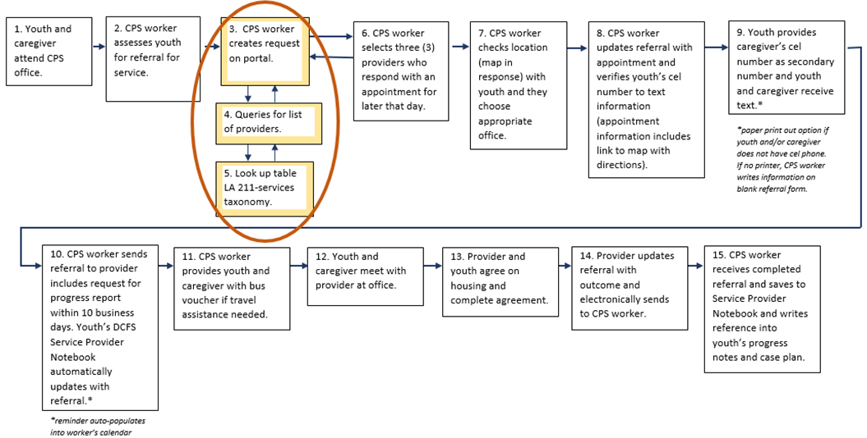
FUTURE STATE: The Process

Slide 6
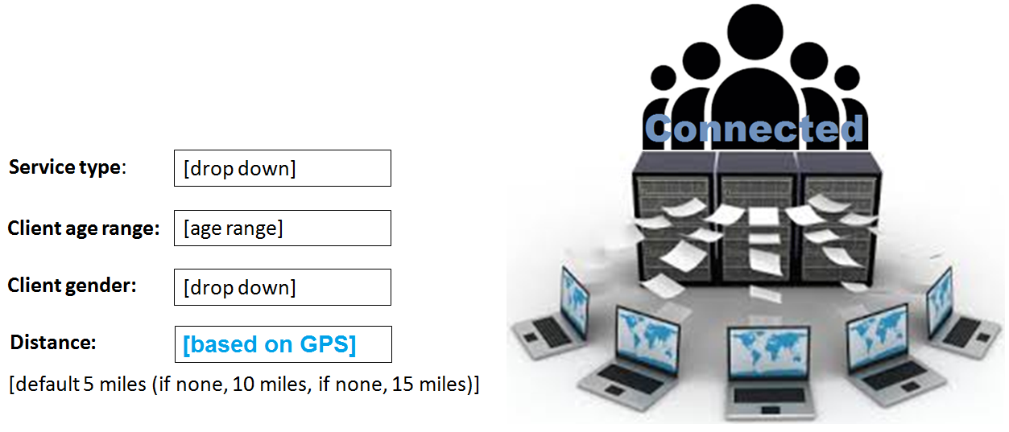
DEMO: API RETRIEVES LIST OF SERVICES
...with the data elements that can be tailored based on family and/or community need(s)

Slide 9
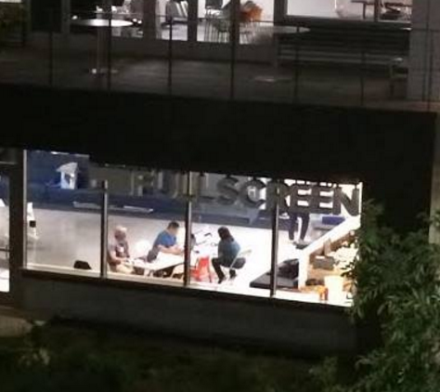
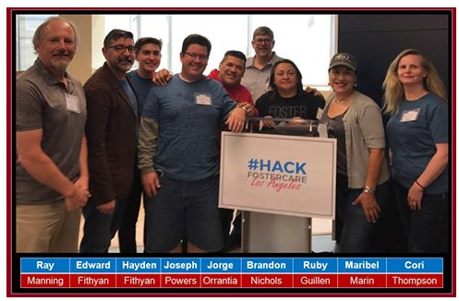
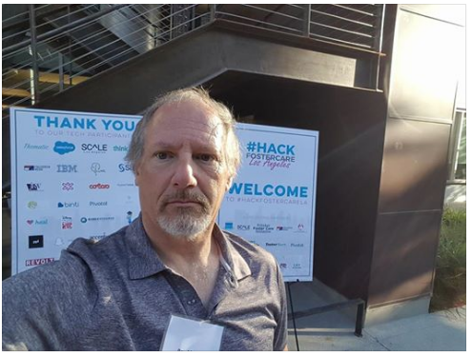
VIDEO DEMO OF REFERRAL SERVICE REQUESTS
Link to video
https://www.youtube.com/watch?v=MKnvS_1_liA&feature=youtu.be

